Slide 1
GridLAB-D Course – Session 1
Introduction and Fundamentals
David P. Chassin
Summer 2016
dchassin@stanford.edu
All registered trademarks are hereby recognized.

Slide 2
Course objectives
Instruct on GridLAB-D
Using the simulation
Adding new models
Addresses the following topics
Using the GridLAB-D modeling (GLM) language
Creating models and optimizing simulations
Administering and configuring GridLAB-D systems
Creating large-scale GridLAB-D operating environments
Programming and debugging with GridLAB-D
Installation and maintenance

Slide 3
What to expect
Does not address the following topics:
How to integrate or link gridlabd with other simulators
How to change how gridlabd works internally
You will need the following to work problems:
A system on which to install GridLAB-D (Windows 64, RHEL-6, or Mac OSX Mavericks or Yosemite)
Install GridLAB-D from SourceForge
Development tools (e.g., svn, gcc/mingw, gdb, lldb)
Install Matlab and MySQL
Course written for Eclipse users, but this is not required
Optional tools include (e.g., gnuplot) not used in this course.

Slide 4
Course outline
Introduction and fundamentals
Power systems
Advanced loads and weather
Markets
Generation
Reliability analysis
Beginning developers – Classes
Intermediate developers – Modules
Advanced developers – Core

Slide 5
Course structure
Instruction
Objectives
Theory and concepts
Methods and applications
Worked examples
Exercises
Problems to solve

Slide 6
Questions?

Slide 7
What is GridLAB-D?
Background on what GridLAB-D
does and how it does it.

Slide 8
Agent-based simulations
What does agent-based mean?
Changing states of each device is modeled independently
Interactions between individuals are captured
Environment in which agents evolve emerges from interactions
Examples:
Social sims (e.g., Repast, Swarm)
Computational economics (e.g., AMES)
Engineered systems (e.g., TRANSIM)
Not examples:
Simcity (it’s cellular automaton-based simulation)
Flight simulator (it’s a model-based simulation)
EPRI DSS (implementation of an algebraic solution)
Any stochastic simulation/model

Slide 9
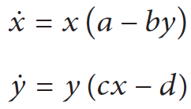

Notional Example: Lotka-Volterra system
Predator-prey population dynamics

Slide 10
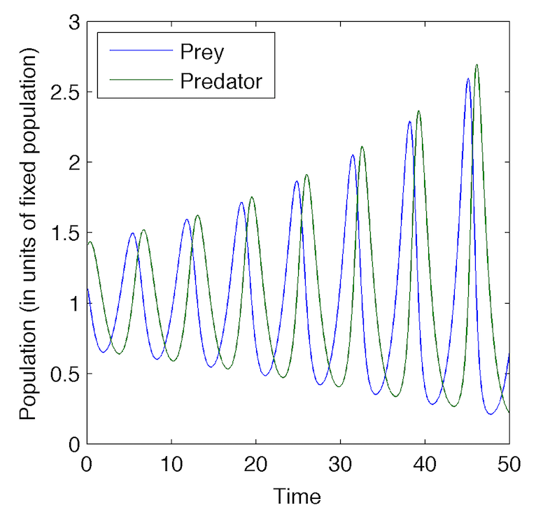
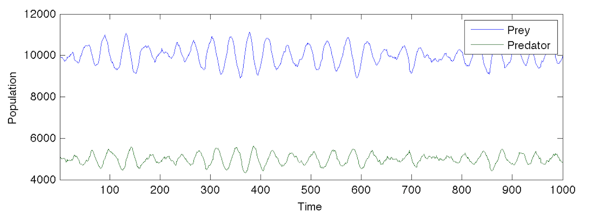
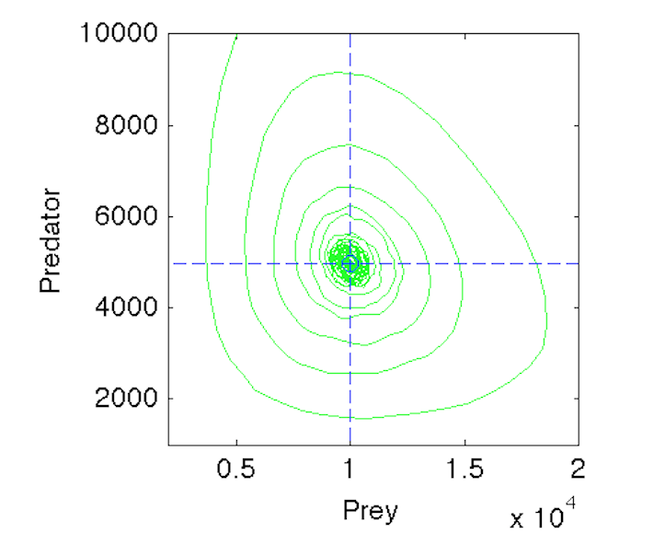
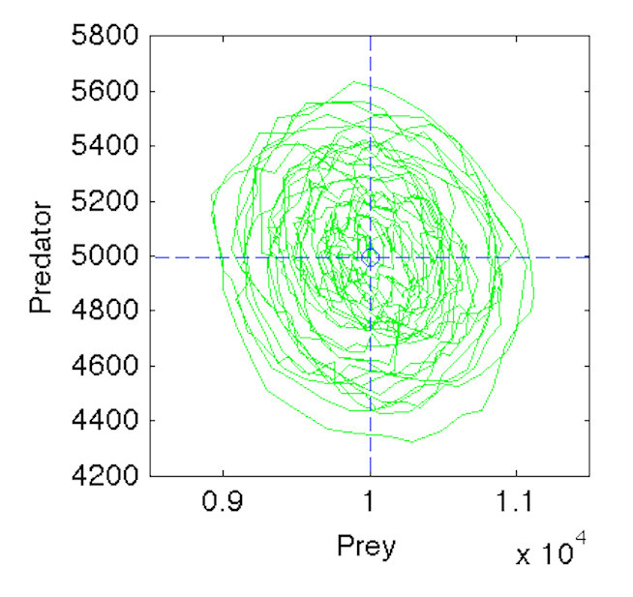
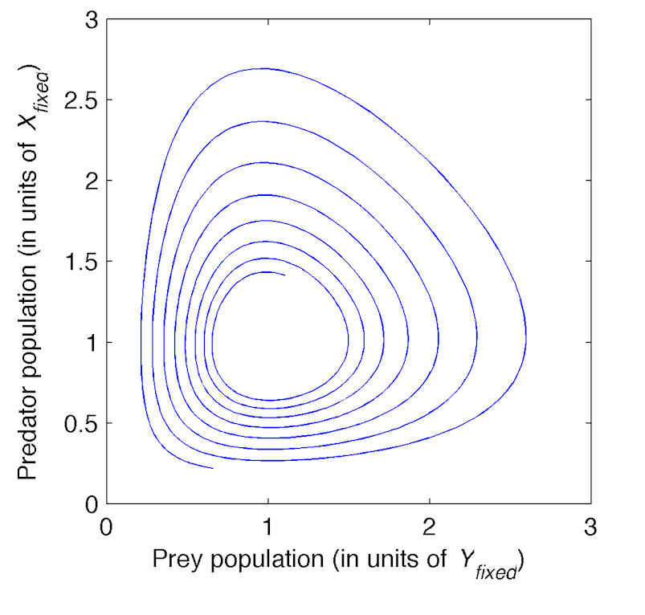
Numerical simulation error
Finite Difference
Agent-based

Slide 11
GridLAB-D simulation method
Time-series of steady states of resolution Δx
with variable time-step of resolution Δt
State (x)
Δx
Δt
Time (t)

Slide 12
Determining next state change
Resolution of multiple overlapping time series
State (x)
Time (t)

Slide 13
Caveats
Iterations are often required to find next state
Non-strictly causal behavior is allowed
No guarantee of convergence
Non-causal behavior is not prohibited
Multiple simultaneous interacting models
Incomplete information exchange
Presence of integral/discrete state variables
Numerous layers of interaction
Makes diagnostics difficult
Can lead to unintended consequences

Slide 14
GLM Files
GLM files describe simulations
Input files (GridLAB-D Model)
Classes, objects, players, recorders and clocks
Strengths
Relatively easy to read and edit
Rich parametric syntax for managing multiple models
Single object definition can become entire populations
Object properties can have distributions
Weaknesses
Not directly compatible with any major software tools
Integration modules/tools have been developed

Slide 15
What is a GLM File?
Declares classes to use
Standard classes are implemented in modules
All classes can be extended at runtime
New classes can be defined at runtime
Defines overall model structure
Establishes initial conditions
Defines certain boundary conditions
Determines starting time and stopping conditions
Constructs inputs and outputs objects
Players, recorders, collectors are objects too
Notes:
Model your own system at the end of the class.
Adding regulators to manage the system
What are the benefits of doing this.
Different type of control schemes
What are the effects of smart meter (price on demand meter), how much does the utitily has to bear.
benefits to customer
profits are less to utility at peak times

Slide 16
What is a module?
Collects classes that are related
Delivers all model functionality related to a particular domain
Loaded on demand
Groups common parameters and domain solvers
Often include module globals to control features
May be proprietary or open-source
Most modules are downloads from SourceForge
Vendor-based distributions possible

Slide 17
Modules Available
Climate (incorporates weather data)
Buildings
Commercial (single-zone office buildings) – in progress
Residential (HVAC and appliance models)
Electrical network
Powerflow (3 phase unbalanced distribution solver – FBS/NR)
Reliability (events, metrics)
Distributed Generators (battery, diesel, PV, wind, inverters) – generalized models – further development this year
Markets
Double and single sided auctions
Appliance controllers
Input/Output
Players, recorders, collectors, MySQL, Matlab

Slide 18
Describing models: classes
Classes define similar objects
Properties are the same for all objects
Behavior are can be set parametrically
Exposed methods (if any) are shared
Static classes are precompiled in modules
Hard to build but very rich and detailed
Runtime classes are user-defined
Easier to build but harder to make detailed
Detail is limited by buffer size and ability to interact with other components
Notes:
Real examples. Explain to me more about this.

Slide 19
Describing systems: objects
Objects are instances of classes
Single instance or population of instances
Object properties
Simple value or distribution of values
Parent-child relation
Primary solver dependency relationship
Child dependent on parent before parent dependent on child
Parent expected to aggregate information from children

Slide 20
Example Object Declaration
Define a house with default values
module residential; // module declaration
object house { // instantiation of an object of class house
name MyHouse; // name the new object
}
Define a house with custom values
module residential;
#include "CA-Los_angeles.glm“ // load weather
object house {
name MyHouse;
floor_area random.normal(1500,300) sf; // random initial value
heating_setpoint 70.0 degF; // heating setpoint
cooling_setpoint 76.0 degF; // cooling setpoint
thermostat_deadband 1.0 degF; // thermostat hysteresis
}

Slide 21
Controlling time: clocks
System clock represents simulation time
Objects have private synchronization clock
Clock time resolution is 1 sec or greater
Cannot represent any time before TS_INIT
TS_INIT is Jan 1, 1970 0:00:00 UTC
Local time based on time zones
Use POSIX standard (e.g., PST+8PDT)
Alternative localization (e.g., US/CA/San Francisco)
Summer (daylight savings) time rules are handled
Summer time rule change years are supported

Slide 22
Clock
Establish the simulation time range for the model
clock {
timezone PST+8PDT;
starttime '2000-01-01 0:00:00 PST';
stoptime '2001-01-01 0:00:00 PST';
}

Slide 23
Example of GLM file
clock {
timezone PST+8PDT;
starttime '2000-01-01 0:00:00 PST';
stoptime '2000-07-01 0:00:00 PST';
}
module residential;
object house {
floor_area random.normal(1500,300) sf;
heating_setpoint 70.0 degF;
cooling_setpoint 76.0 degF;
thermostat_deadband 1.0 degF;
}

Slide 24
Questions?

Slide 25
Running Simulations
Details on how to run and control
GridLAB-D models

Slide 26
Specifying input file
To run a GLM file
Command line must point to location of the executable
host% gridlabd run_file.glm

Slide 27
Saving output
Output by default goes to current executable location
Only saves final state of the system
Sending output to another file
host% gridlabd file1.glm -o file1.xml
Saves the instance this run created
Be careful not to overwrite input file
host% gridlabd file1 -o file1.glm

Slide 28
Controlling output messages
Warnings can be disabled
host% gridlabd --warn file1.glm
Verbose output can be enabled
host% gridlabd --verbose file1.glm
Debug messages can be toggled
host% gridlabd --debug file1.glm
Quiet suppresses almost all messages
host% gridlabd --quiet file1.glm

Slide 29
Controlling global parameters
Many parameters have global or module scope
Custom model parameters also allowed
Parameters are defined as model globals
host% gridlabd –D name=value file1.glm
Modules can also have their own globals
host% gridlabd –D module::name=value file1.glm
(More about this when using GLM macros)

Slide 30
Some useful global variables
iteration_limit | Maximum number of iterations allowed before convergence fails (default=100)
dumpfile | File to use for model dump if simulation fails (default=gridlabd.xml)
stoptime | Simulation time at which to stop regardless of state (default=never)
kmlfile | Google Earth output file (default=gridlabd.kml)
urlbase | URL base for stylesheets when viewing XML files in a browser (default=http://www.gridlabd.org)
timezone | The default timezone to use if non specified in the model (default=locale)
randomseed | Deterministic pseudo-random number seed; 0 means non-deterministic random numbers (default=0)

Slide 31
Reading error messages
Loader messages
file.glm(line): load message
Compiler messages
file.glm(line): cpp message
-or-
file.cpp(line): cpp message
Simulator runtime messages
ERROR[timestamp]: exec message

Slide 32
Configuration files
gridlabd.conf
System copy is in /usr/local/share/gridlabd folder
A local copy will override system copy
Has system-wide settings
Must be valid for all users
gridlabd-user.conf
User-specific settings
Based on USER or USERNAME environment variable
Can be loaded /usr/local/share/gridlabd configuration file

Slide 33
Questions?

Slide 34
Getting Help
How to get help and report problems.

Slide 35
Help Resources
Runtime resources
--help, --modhelp module[:class]
Troubleshooting pages
Documents warning and error messages
SF Wiki
Latest documentation
Searchable and you can make edits (registered users)
SF Forums
Questions not covered by Wiki
All users see answer
SF user emails
Ok, but not always as quick
Other users don’t benefit from answer
SF TRAC
Used if none of the above addresses the problem
Used to report “bugs” or requested upgrades

Slide 36
Command line: --help
host% gridlabd --help
Syntax: gridlabd [<options>] file1 [file2 [...]]
Command-line options
--------------------
--check|-c Performs module checks before starting simulation
--debug Toggles display of debug messages
--debugger Enables the debugger
--dumpall Dumps the global variable list
--mt_profile <n-threads> Analyses multithreaded performance profile
--profile Toggles performance profiling of core and modules while simulation runs
--quiet|-q Toggles suppression of all but error and fatal messages
--verbose|-v Toggles output of verbose messages
--warn|-w Toggles display of warning messages
--workdir|-W Sets the working directory
Global and module control
-------------------------
--define|-D <name>=[<module>:]<value> Defines or sets a global (or module) variable
--globals Displays a sorted list of all global variables
--libinfo|-L <module> Displays information about a module
Information
-----------
--copyright Displays copyright
--license Displays the license agreement
--version|-V Displays the version information
--setup Open simulation setup screen
...

Slide 37
Command line: --modhelp tape:player
host% gridlabd --modhelp tape:player
module tape {
char1024 gnuplot_path;
int32 flush_interval;
int32 csv_data_only;
int32 csv_keep_clean;
timestamp delta_mode_needed;
}
class player {
char256 property;
char1024 file;
char8 filetype;
char32 mode;
int32 loop;
}

Slide 38
Command line: --modhelp
host% gridlabd --modhelp powerflow:line
module powerflow {
bool show_matrix_values;
double primary_voltage_ratio;
double nominal_frequency;
bool require_voltage_control;
double geographic_degree;
complex fault_impedance;
double warning_underfrequency;
double warning_overfrequency;
double warning_undervoltage;
double warning_overvoltage;
double warning_voltageangle;
double maximum_voltage_error;
enumeration {NR=2, GS=1, FBS=0} solver_method;
bool line_capacitance;
bool line_limits;
char256 lu_solver;
int64 NR_iteration_limit;
int32 NR_superLU_procs;
double default_maximum_voltage_error;
double default_maximum_power_error;
bool NR_admit_change;
bool enable_subsecond_models; // Enable deltamode capabilities within the powerflow module
bool all_powerflow_delta; // Forces all powerflow objects that are capable to participate in deltamode
double deltamode_timestep[ns]; // Desired minimum timestep for deltamode-related simulations
int64 deltamode_extra_function;
double current_frequency[Hz]; // Current system-level frequency of the powerflow system
bool master_frequency_update; // Tracking variable to see if an object has become the system frequency updater
bool enable_frequency_dependence; // Flag to enable frequency-based variations in impedance values of lines and loads
double default_resistance;
bool enable_inrush; // Flag to enable in-rush calculations for lines and transformers in deltamode
double low_voltage_impedance_level; // Lower limit of voltage (in per-unit) at which all load types are converted to impedance for in-rush calculations
char1024 market_price_name;
}
...
Notes:
What is the purpose of this slide?

Slide 39
Command line: --modhelp
host% gridlabd --modhelp powerflow:line
...
class line {
parent link;
class link {
parent powerflow_object;
class powerflow_object {
set {A=1, B=2, C=4, D=256, N=8, S=112, G=128} phases;
double nominal_voltage[V];
}
function interupdate_pwr_object();
function update_power_pwr_object();
function check_limits_pwr_object();
enumeration {OPEN=0, CLOSED=1} status; //
object from; // from_node - source node
object to; // to_node - load node
complex power_in[VA]; // power flow in (w.r.t from node)
complex power_out[VA]; // power flow out (w.r.t to node)
double power_out_real[W]; // power flow out (w.r.t to node), real
complex power_losses[VA]; // power losses
complex power_in_A[VA]; // power flow in (w.r.t from node), phase A
complex power_in_B[VA]; // power flow in (w.r.t from node), phase B
complex power_in_C[VA]; // power flow in (w.r.t from node), phase C
complex power_out_A[VA]; // power flow out (w.r.t to node), phase A
complex power_out_B[VA]; // power flow out (w.r.t to node), phase B
complex power_out_C[VA]; // power flow out (w.r.t to node), phase C
complex power_losses_A[VA]; // power losses, phase A
complex power_losses_B[VA]; // power losses, phase B
complex power_losses_C[VA]; // power losses, phase C
complex current_out_A[A]; // current flow out of link (w.r.t. to node), phase A
complex current_out_B[A]; // current flow out of link (w.r.t. to node), phase B
complex current_out_C[A]; // current flow out of link (w.r.t. to node), phase C
complex current_in_A[A]; // current flow to link (w.r.t from node), phase A
complex current_in_B[A]; // current flow to link (w.r.t from node), phase B
complex current_in_C[A]; // current flow to link (w.r.t from node), phase C
complex fault_current_in_A[A]; // fault current flowing in, phase A
complex fault_current_in_B[A]; // fault current flowing in, phase B
complex fault_current_in_C[A]; // fault current flowing in, phase C
complex fault_current_out_A[A]; // fault current flowing out, phase A
complex fault_current_out_B[A]; // fault current flowing out, phase B
complex fault_current_out_C[A]; // fault current flowing out, phase C
set {CN=768, CR=512, CF=256, BN=48, BR=32, BF=16, AN=3, AR=2, AF=1, UNKNOWN=0} flow_direction; // flag used for describing direction of the flow of power
double mean_repair_time[s]; // Time after a fault clears for the object to be back in service
double continuous_rating[A]; // Continuous rating for this link object (set individual line segments
double emergency_rating[A]; // Emergency rating for this link object (set individual line segments
double inrush_convergence_value[V]; // Tolerance, as change in line voltage drop between iterations, for deltamode in-rush completion
}
function interupdate_pwr_object();
function update_power_pwr_object();
function check_limits_pwr_object();
object configuration;
double length[ft];
}
Notes:
What is the purpose of this slide?

Slide 40
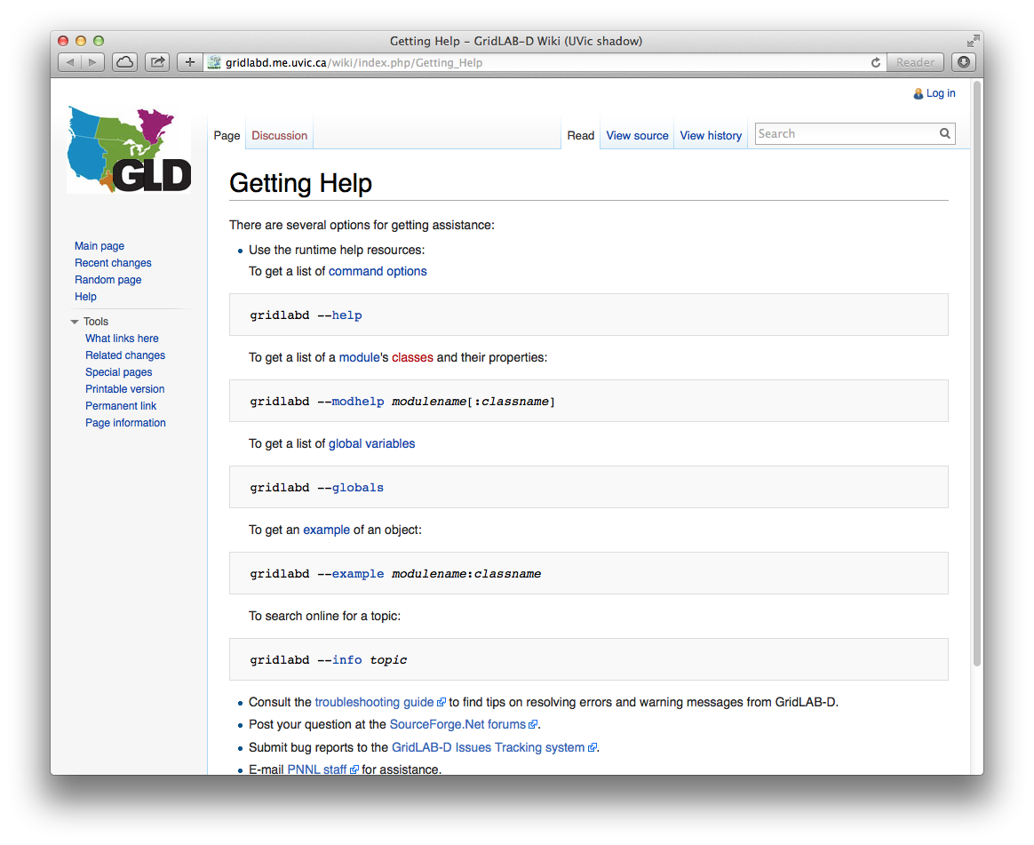
Command line: --info <topic>
Searches wiki pages for the topic
host% gridlabd --info "Getting help"

Slide 41
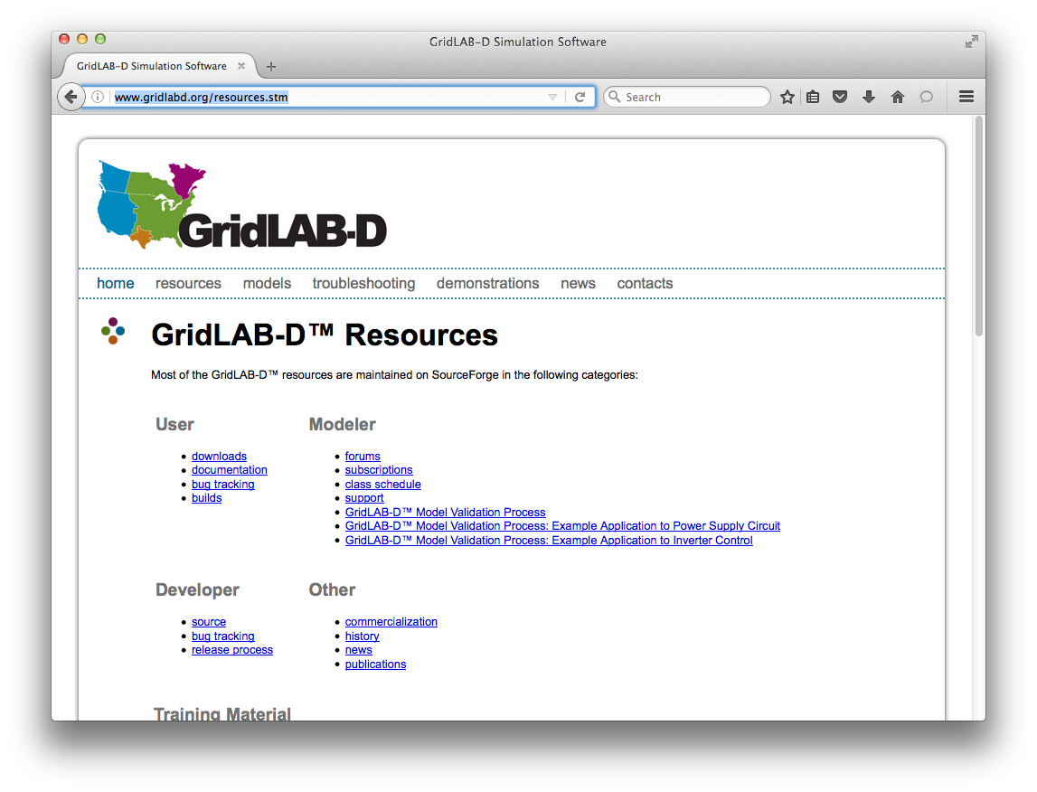

Online help resources

Slide 42
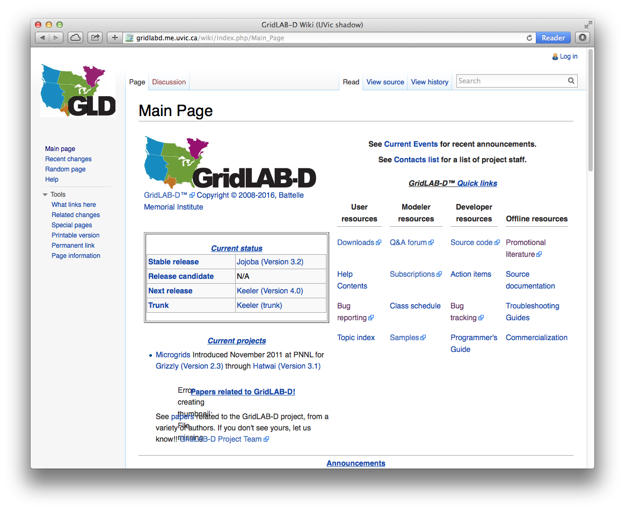
SourceForce MediaWiki

Slide 43
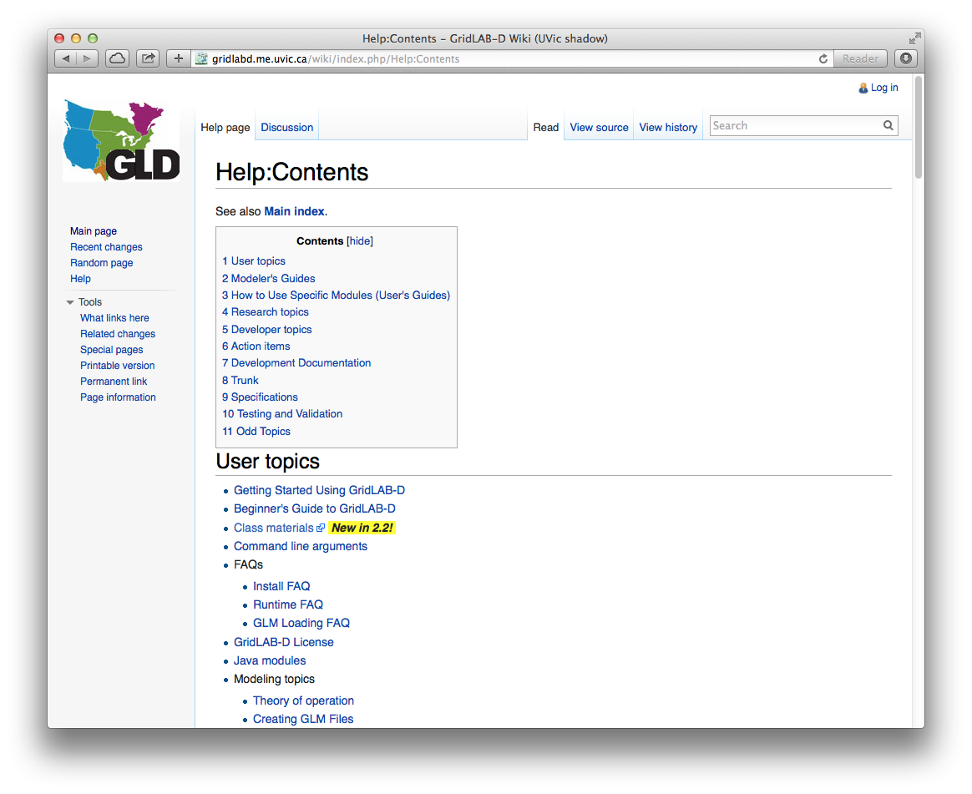
Help Guides

Slide 44
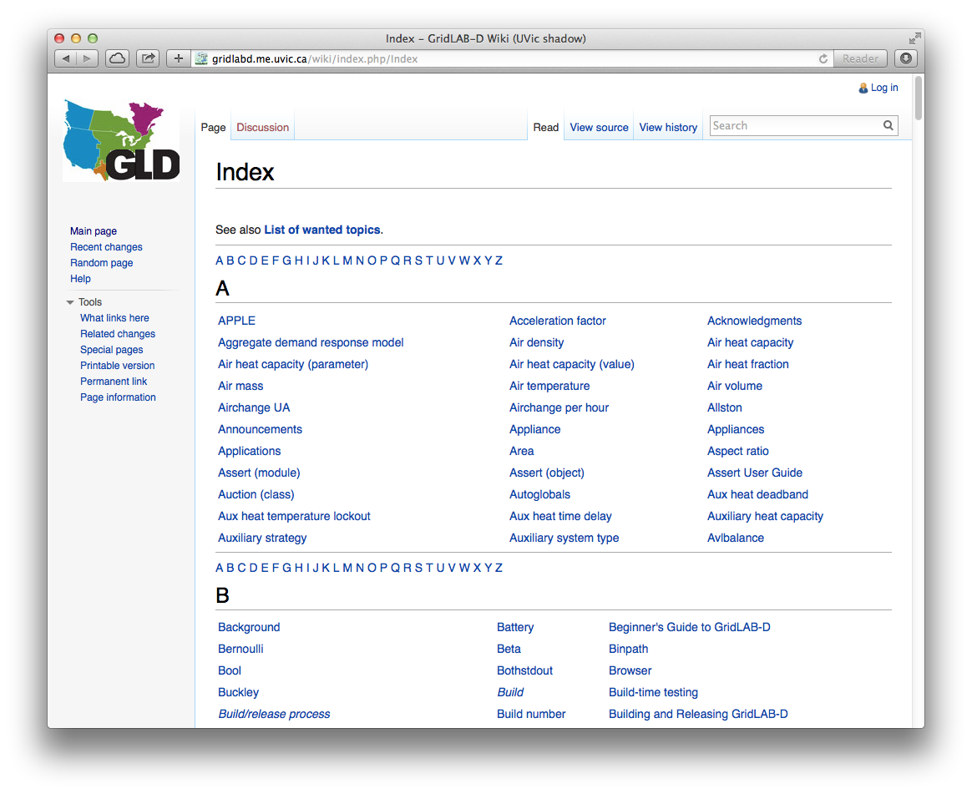
Topic Index

Slide 45
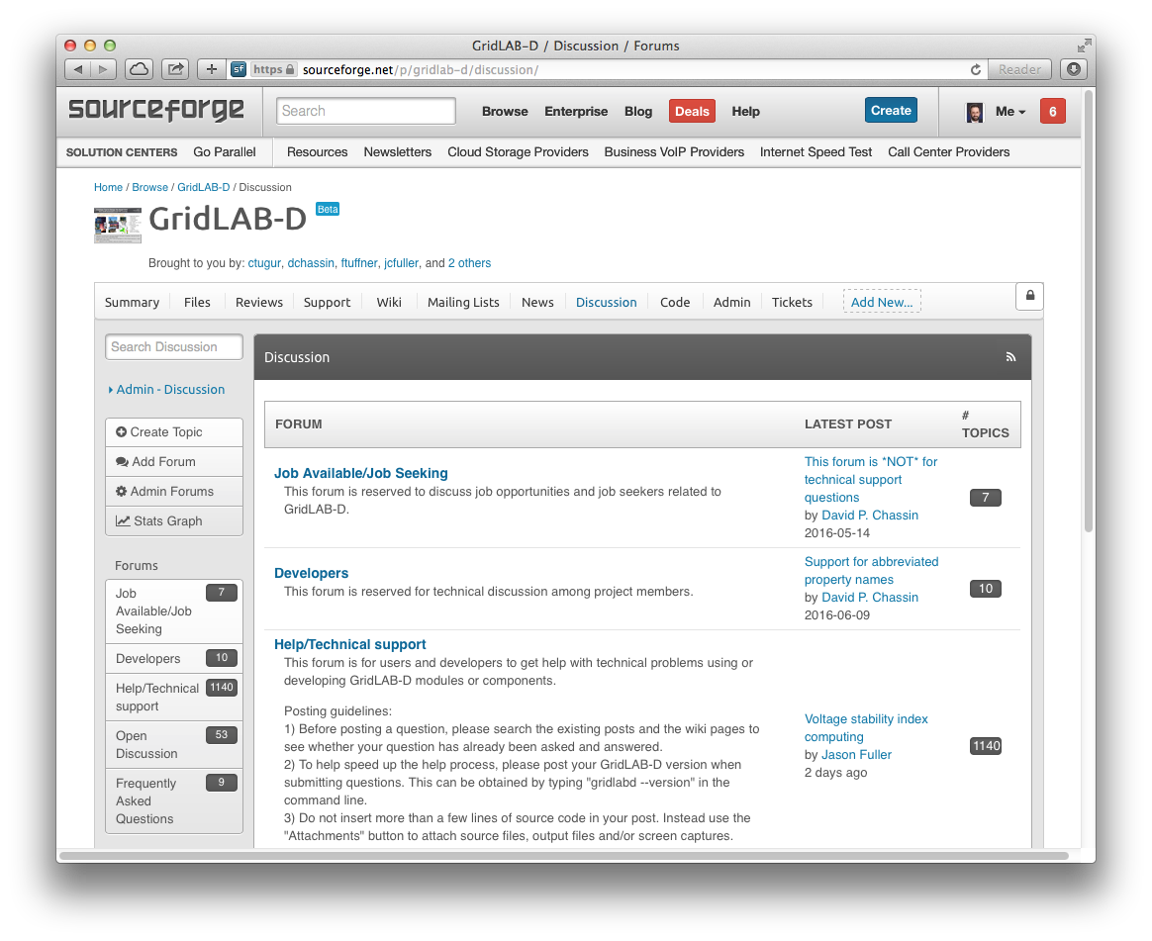
Forum

Slide 46
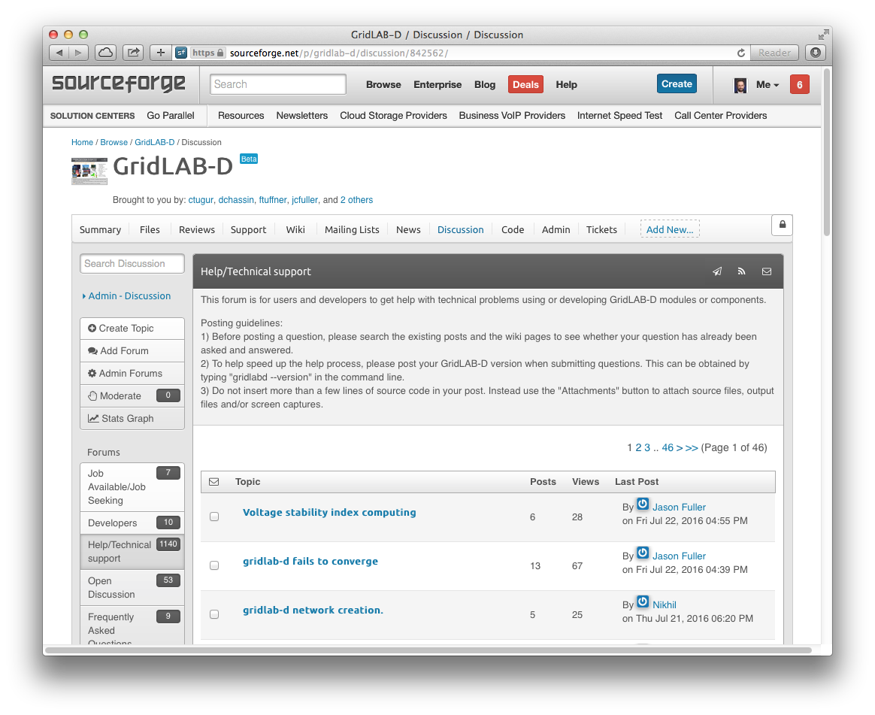
Posting to the forum

Slide 47
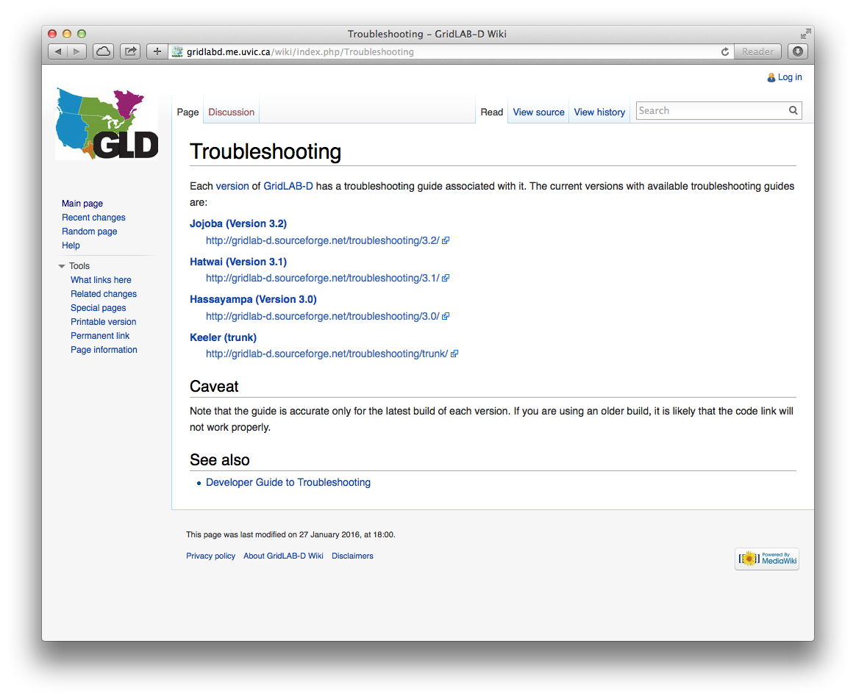
Troubleshooting

Slide 48
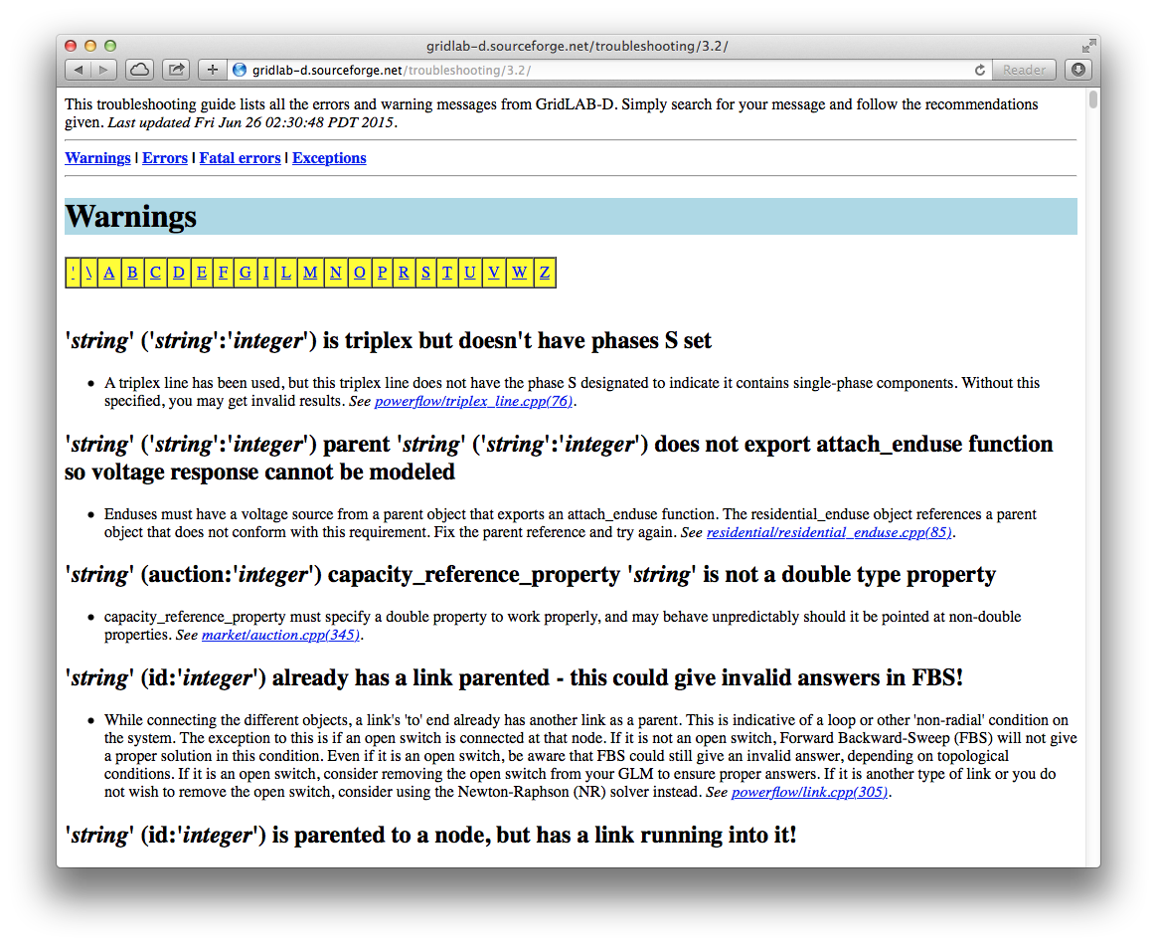
Troubleshooting

Slide 49
Questions?

Slide 50
Modeling language basics
Detailed discussion of GridLAB-D modeling language (GLM).

Slide 51
Top-level Directives
Instructs loader on the content of the next GLM block
clock – controls time
module – loads groups of classes and functions
class – defines a class
object – defines an object
import – imports a model
export – exports a model
link – links a model to an external tool
filter – defines a filter to connect object properties
extern – defines a function to connect object properties

Slide 52
Clock directive
clock {
timezone PST+8PDT;
starttime '2001-01-23 01:23:45 PST';
stoptime '2001-06-12 01:23:45 PDT';
}
Specifies the timezone (must come first)
Sets the start time
Sets the end time (if steady state not reached first)

Slide 53
Module directive
module powerflow {
solver_method NR;
NR_iteration_limit 50;
}
Loads the named module
Sets the module’s variables (overrides default)
Modules define one or more classes
Modules often come with other functions

Slide 54
Class directive
class house {
double floor_area[sf];
}
Asserts structure of an existing class
Load fails if actual structure does not match
Add new variables to an existing class
Type, name and units are defined.
Can be used to create a new class
Must include init and sync (more on this later)
(Windows users must installed mingw)

Slide 55
Property types
bool
char8, char32, char256, char1024
int8, int16, int32, int64, timestamp,
enumeration, set
double, complex, float, real, randomvar, double_array,
loadshape, enduse, object

Slide 56
Example property values
is_enabled TRUE; // boolean
motor_state STALLED; // set/enumeration
city "Richland"; //char*
start_at '2008-04-01 12:00:00 PDT'; // timestamp
floor_area 2000; // double
floor_area 250 m^2; // double with units
floor_area random.triangle(1500,2500); // functional
wall_area (sqrt($var)*8); // calculated
name `{class}:{id}`; // expansion
name ${var++}; // expression
test_result (test_value) ? "<=0" : ">0"; // trinary

Slide 57
Property units
Defines how values are stored in memory
Double and complex converted automatically
General unit conversion system used
Standard units (m, W, V, A, h, s)
Conventional units (kW, kVA, Btu)
Derived units (e.g., MW/h)—beware of quirks
Complete list of units in unitfile.txt
If unit is not define the value is dimensionless
If unit is not specified the property’s unit is assumed

Slide 58
Reserved property names
Used by object headers
Cannot be used in class definitions
class invalid {
object parent;
}
Can be set in object definitions
object dryer {
parent my_house;
}
parent
rank
clock
valid_to
latitude
longitude
in_svc
out_svc
flags

Slide 59
Object directive
Basic syntax
object classname {
property_name value;
...
}
Defining multiple objects at once
object class:..count ...
Numerical identifiers
object class:num ...
object class:first..last ...

Slide 60
Rules for values
Double quotes required if string has spaces
Non-string values are converted automatically
Quotes suppress all other rules (math, expansions, etc.)
Times and other special types
Requires single quotes when spaces are included
Functional values allowed outside parentheses
random.dist(args...)
Some properties use extended syntax, e.g.,
my_randomvar {type:normal(0,1); min:0; refresh:30s; };

Slide 61
Expression syntax
Standard math operations used
((12+8)/9)
Usual math functions supported
(sin((12+8)/2*Pi))
Can refer to other properties of object, e.g.,
(… $property_name …)
(… this.property_name …)
(… parent.property_name …)
(… object.property_name …) ← caveat!

Slide 62
Functionals
Only for random numbers
Distributions require arguments
Discrete distributions
degenerate(x)
bernoulli(p)
sampled(n,x₁,x₂,…,x_{n})
Others likely coming
Continuous distributions
uniform(a,b)
normal(m,s)
lognormal(m,s)
exponential(l)
pareto(m,g)
beta(a,b)
gamma(a,b)
weibull(l,k)
rayleigh(s)
triangle(a,b)

Slide 63
Nested objects
Implicit parent-child relationship
Allows generation of population
Avoid having to provide names
Equivalent:
object house { object house {
object dryer { name my_house;
... ...
}; }
... object dryer {
} parent my_house;
...
}
No equivalent: object house:..10

Slide 64
Macro processing
Hash (#) in first non-white of a line specifies macros
Macro processing is done first
New values stored as global variables
#define MYDEF=text
Inline substitutions of macros syntax
${MYDEF}
Environment variables also substituted
${USER}

Slide 65
Standard macros
Standard expressions
#include filename
#print expression
#warning message
#error message
#define name=value
#set name=value
#setenv name=value
Conditionals
#if expression
#else
#endif
#ifdef name
…
#ifndef name
…
#ifexist file
…

Slide 66
Schedules, Loadshapes, and Enduses
schedule directive is available
Provides efficient built-in support for periodic values
Loadshape property
Reads a schedule to update load
Implements various typical load behaviors
Enduse property
Reads loadshape
Synthesize power demand

Slide 67
Questions?

Slide 68
Data Input and Output
Introduce objects that control flow of data in and out of GridLAB-D.

Slide 69
Extracting final results: XML dump
XML files describe models
Classes, objects, players, recorders and clocks
Strengths
Highly compatible with other software
Faithful representation of a single model instance
Weaknesses
Viewing and editing only with third-party tools
Rigid (non-parametric) syntax
Not good for creating large complex models
No populations or distribution allowed
Not easily used for extraction of time series data

Slide 70
Extracting intermediate results
Recorders
Samples a single object’s properties at designated times
Handles unit conversion if unit is specified
Samples stored in file or database (depends on module)
Triggers can start recording conditionally
Limits can end recording conditionally
Multi-recorder
Multi-object variant records several objects
Collector
Aggregates samples (e.g., mean, stdev, min, max, etc.)
Histogram
Counts samples in bins, saves and reset at intervals

Slide 71
Introducing data
Players
Alter object properties at designated times
Used to alter boundary conditions
Can use relative time and looped
Shapers
Schedules (using POSIX cron standard)
Amplitude: copies value directly
Pulse-width: on/off with a probability
Queues: accrues to threshold before “on”

Slide 72
Tape Module
Changing properties
Player
Shaper
Sampling properties
Recorder
Multi_recorder
Collector
Histogram
Group_recorder
Violation_recorder
MySQL Module
Database
Mimics tape module
Player
Recorder
Collector

Slide 73
Internal data sources and links
Schedules
Represent periodic data (minute, hour, day, month, weekday)
More efficient than player or shaper objects
Preloaded into core memory on initialization
Often used in conjunction with loadshape and enduse
Transforms
Defines reusable functions to transform a source property and apply it to a destination property
Filter
Defines a reusable discrete-time digital filter to transform a source property and apply the result to a destination property

Slide 74
Summary
Player and Shaper
Used to update information at a specific time from a file
Recorder and Collector
Used to collect information from the model
Can also plot to screen or file
Loadshapes and Schedules
NOT part of the tape module, but similar functionality
Updates recurring information at a specific time directly from the core (not from a file)
Transforms and Filters
Uses data from a source variable to modify other properties

Slide 75
Players
Objects that set and control the boundary conditions.

Slide 76
Input object: player
Implemented in tape and mysql modules
One of three primary ways of inputting data
Tapes apply a time-series to a single property of the parent object
Several possible sources of tape data
File : source is a CSV files
ODBC : source is a database
Memory : source is a global variable
MySQL : source is a table

Slide 77
Player timestamps
Timestamp is the beginning of interval
Absolute time uses ISO time format
YYYY-MM-DD hh:mm:ss [ZZZ]
Missing timezone implies UTC (not local timezone!)
Relative times use “+” prefix, e.g., “+600”
Relative times can have units (default is seconds)
“s”, “m”, “h”, “d”, “w”,
Examples: +12h
Warning: “m” is not the standard unit for minutes. The tape modules does not use GridLAB-D’s unit conversion system, in which the standard unit for a minute is “min”.

Slide 78
Player “property”
Name of parent’s property that is updated
Data conversion is automatic
Conversion is from text input
Boolean uses TRUE or FALSE and/or 0 or 1
Integer uses atoi()
Enumeration/set uses keywords (specific to property)
Double uses double_format (a global variable)
Complex uses complex_format (a global variable)
Object references use object_scan format (global)
Warning: Tape player does not support units but mysql player does.

Slide 79
Player “file”
Determines the source CSV file of the data
Require that file property be the filename
Format is CSV, but others may be coming
Directory delimiter can be system specific
“/” are normally used; “\” allowed in Windows
Meaning differs based on filetype property
Default is “txt”
“odbc” is for databases: file is connection string
“memory” is for Matlab data: file is global variable name
Not supported in mysql player

Slide 80
Player “loop”
Indicates how many times the data source is to be read
Default (0) is to not loop
Absolute timestamps are read only on first pass
Relative time offsets are used on all passes

Slide 81
Example player object
object house {
floor_area random.normal(1500,300);
object player {
property air_temperature;
file "tair.csv”
loop 10;
};
}

Slide 82
Example player file
# comment lines start with hash sign
# this example will produce a square wave timeseries
# alternating every hour between 72 and 73
# this is an absolute timestamp
# it is read only on the first pass
2007-01-01 00:00:00, 72.0
# these are relative timestamps
# they are read on every pass
+1h, 73.0
+1h, 72.0

Slide 83
Another Example
Another way to code
object house:1 {
floor_area random.normal(1500,300);
}
object player {
parent house:1
property air_temperature
file "tair.csv";
loop 21;
}

Slide 84
Yet another Example
Another way to code
object house {
name MyHouse1;
floor_area random.normal(1500,300);
}
object player {
parent MyHouse1;
property air_temperature
file "tair.csv";
loop 21;
}

Slide 85
Another example player file
# comment lines start with hash sign
# this example will produce a time series of
# temperatures for midnight-3 am, then stay at
# 68.0 degrees indefinitely
2007-01-01 00:00:00, 72.0
2007-01-01 01:00:00, 73.0
2007-01-01 02:00:00, 72.0
2007-01-01 03:00:00, 68.0

Slide 86
Demo
Manipulate thermostatic controls using player: player.glm
clock {
timezone PST+8PDT;
starttime '2001-01-01 00:00:00 PST';
}
module residential;
module tape;
object house {
heating_setpoint 40 degF;
cooling_setpoint 90 degF;
object player {
property cooling_setpoint;
file theat.csv;
loop 28;
};
}

Slide 87
Demo
Another way to manipulate values using player: player_2.glm
clock {
timezone PST+8PDT;
starttime '2001-01-01 00:00:00 PST';
}
module residential;
module tape;
object house {
name MyHouse1;
heating_setpoint 40 degF;
cooling_setpoint 90 degF;
}
object player {
parent MyHouse1;
property cooling_setpoint;
file theat.csv;
loop 28;
}

Slide 88
Example player file: theat.csv
2001-01-02 06:00:00,75
+15h,60
+9h,75
Note: Excel does not handle ISO date formats, timezones, or daylight savings time rules correctly. To avoid issues, use UTC time for all timestamps as much as possible.
Tip: In Excel use custom cell formats for timestamps:
yyyy-mm-dd HH:MM:SS
yyyy-mm-dd HH:MM:SS "PST"

Slide 89
Player transforms
object class {
property source*scalar+offset;
}
Used to create a linear function of value
y = m*x + b
A single common input used by multiple objects
Easy offsets and scaling of shapes from a single source

Slide 90
Player transforms
Created in multiple steps:
// trick to publish the input value when no parent is set
class player { // this only needs to be done once
double value; // at the beginning of the glm file
}
object player { // this is only done once for each input
name THeat;
file theat.csv;
loop 5;
}
object house:1 {
heating_setpoint THeat.value*1+2; // syntax and order important
}
object house:2 {
heating_setpoint THeat.value*1.1+4; // using different offset/scale
}
This input can now be used by many objects

Slide 91
ODBC Tapes
ODBC data for players and recorders only
file odbc:[DSN][:uname:pwd]:[objName];
file odbc:MyDataSource:user:secret:MyHouse1;
Keys entries by tape name and object name
Expects fixed table names, replaces same-key objects each run
Note: multiple properties are processed together as a single “column”

Slide 92
ODBC Tape Tables
EVENT_TABLE and OBJECT_TABLE
EVENT_TIME | TIMESTAMP
EVENT_VAL | String
EVENT_OBJECT_NAME | Char32
EVENT_LINE | Integer
HEADER_TABLE
HEADER_OBJECT_NAME | String
HEADER_TIME | String
HEADER_USERNAME | String
HEADER_HOSTNAME | String
HEADER_TARGET | String
HEADER_PROPERTY | String
HEADER_INTERVAL | Long
HEADER_LIMIT | Long
OBJECT_TABLE writes recorder output.
EVENT_TABLE reads player input.
EVENT_LINE records the order in which lines are to be read.
HEADER_TABLE is only written to. Only HEADER_OBJECT_NAME is referenced by the system, and writes the recorder’s name.
Time, username, hostname, target, property, interval, and limit all correspond with the CSV file header output.

Slide 93
MySQL player
Very similar to tape player objects
Requires database object to operate
If none use, the default database is used
Default database is specified by module declarations
module mysql {
hostname "localhost";
username "gridlabd";
password "";
schema "gridlabd";
port 3306;
socketname "/tmp/mysql.sock";
clientflags COMPRESS|FOUND_ROWS|IGNORE_SIGPIPE|INTERACTIVE|LOCAL_FILES|MULTI_RESULTS|MULTI_STATEMENTS|NO_SCHEMA|ODBC|SSL|REMEMBER_OPTIONS;
}

Slide 94
MySQL database
object database {
hostname "localhost";
username "gridlabd";
password "";
schema "gridlabd";
port 3306;
socketname "/tmp/mysql.sock";
clientflags COMPRESS|FOUND_ROWS|IGNORE_SIGPIPE|INTERACTIVE|LOCAL_FILES|MULTI_RESULTS|MULTI_STATEMENTS|NO_SCHEMA|ODBC|SSL|REMEMBER_OPTIONS;
options SHOWQUERY|NOCREATE|NEWDB|OVERWRITE;
on_init sql-script-name;
on_sync sql-script-name;
on_term sql-script-name;
sync_interval seconds;
}

Slide 95
MySQL player
object player {
property property-name;
table|file source-table;
mode {"r","r+"};
filetype {"CSV"};
connection database-object-name;
options 0;
loop number-of-loops;
}

Slide 96
Questions?

Slide 97
Recorders
This section will introduce you to objects that record data in other objects.

Slide 98
Output object
Implemented in tape and mysql module
One of two primary ways of collecting data
One of few objects which “drive” the simulation
Recorders observe one or more properties of a single object
Several possible destinations for data (tape)
File : source is a specially formatted files
ODBC : source is a database
Memory : source is a global variable
Plot : gnuplot output

Slide 99
Property
Name of parent’s property that is recorded
Internal data conversion is performed
Conversion is to text output
Booleans uses TRUE or FALSE and/or 0 or 1
Integers use decimal integer
Enumerations and set use keywords
Doubles use double_format
#set double_format=%.12lg allows user to modify format
Complex uses complex_format
Object references use object_format

Slide 100
Property (cont.)
Unit conversion only performed if unit is specified
property name[unit];
Example:
object house {
floor_area random.triable(1000,2000) sf;
object recorder {
property floor_area[m^2];
// ...
};
}
Additional extensions used for complex numbers
real, imag, mag, ang, arg
property voltage_A.real;

Slide 101
File
Meaning differs based on filetype property
Format can be system specific
“/” are normally used; “\” allowed in Windows
File must be writeable
Path to file is not automatically created
Existing files are overwritten
Note: Write failure is not an error (simulation continues with a warning)

Slide 102
Interval
Determines the sampling interval for data
How often should I sample?
Units are seconds
-1 means sample transients (on change)
0 means sample each iteration
Interval “drives” simulation
Affects numerical results if models don’t handle transients well
Note: recording samples are lagging (unlike players, which are leading)

Slide 103
Limit
The maximum number of samples
How many samples should I record?
Limits the size of the output file
0 is default
0 means no limit
Note: If a “stoptime” is not specified, simulation runs until all recorders reach their limits.

Slide 104
Trigger
Specifies condition to start recording
Works only for the target property
Usual compare operations apply
Once triggered, recording continues to limit
Example
trigger "< 0"; // start recording when target is negative

Slide 105
Multi-Recorder
Same basic syntax as a recorder
Allows user to record from multiple objects into a single file
Example:
object meter {
name meter1;
phases ABCN;
nominal_voltage 7200;
object multi_recorder {
property "measured_real_power,meter2:constant_power_A_real";
limit 8808;
interval 1800;
file record_power.csv;
};
}
non-parent object

Slide 106
Demo
// player_recorder.glm
module residential;
module tape;
clock {
timezone PST+8PDT;
starttime '2001-01-01 00:00:00 PST';
}
object house:1 {
heating_setpoint 40degF;
cooling_setpoint 90degF;
}
object player {
parent house:1;
property cooling_setpoint;
file theat.csv;
loop 100; // does not drive simulation
}
object recorder{
parent house:1;
property air_temperature,cooling_setpoint;
file theat_record.csv;
interval 7200; // 2 hours
limit 48; // records 48 samples -> drives simulation for 96 hours
}

Slide 107
Demo
// player_recorder_interval.glm
module residential;
module tape;
clock {
timezone PST+8PDT;
starttime '2001-01-01 0:00:00 PST';
}
object house:1 {
heating_setpoint 40degF;
cooling_setpoint 90degF;
}
object player {
parent house:1;
property cooling_setpoint;
file theat.csv;
loop 100;
}
object recorder{
parent house:1;
property air_temperature,cooling_setpoint;
file theat_record_0.csv;
interval 0; // sample each iteration (9pm and 6am from player)
limit 48;
}

Slide 108
Example: intervals
// Interval -1, 0, 7200: player_recorder_trio.glm
object player {
parent house:1;
property cooling_setpoint;
file theat.csv;
loop 100;
}
object recorder{
parent house:1;
property air_temperature,cooling_setpoint;
file theat_record_7200.csv;
interval 7200; // records every 2 hours for 48 x 2 hours
limit 48;
}
object recorder{
parent house:1;
property air_temperature,cooling_setpoint;
file theat_record_0.csv;
interval 0; // records every iteration (9pm and 6am from player)
limit 48;
}
object recorder{
parent house:1;
property air_temperature,cooling_setpoint;
file theat_record_1.csv;
interval -1; // record every change in value when clock advances
limit 48;
}

Slide 109
Questions?

Slide 110
Collectors
Objects that record aggregate data from groups of objects.

Slide 111
Output object
Implemented in tape and mysql module
One of two primary ways of recording data
Same basic parameters as recorders
Collectors take aggregates of properties
Observations collected from a group of objects
Aggregations include statistics and min/max
Aggregations are specified as part of property

Slide 112
Group
Defines the subset of objects to observe
Object properties used to define group
Header properties allowed:
class, parent, rank, in_svc, out_svc, groupid
Search is performed only on first observation
Search result is reused thereafter
=> Groups must be constant over time
=> Only time-invariant properties may be used in group criteria
Example: group "class=house";
Can include multiple groupings
group "class=house AND groupid=feeder1"

Slide 113
Property aggregators
Similar to recorders, but with aggregators
count, min, max, avg, std, sum, prod
mean, var, kur
gamma
Parts used for complex values
real, imag
mag, ang, arg
Example: property "sum(power.mag)"

Slide 114
Example
object collector {
group “class=house AND groupid=feeder1”;
property “sum(power.mag),avg(hvac_load.real)”;
interval 3600;
limit 24;
}

Slide 115
Demo
// demo/collector.glm sum and average of the real power of light objects in houses
module residential{
implicit_enduses NONE;
}
module tape;
clock {
timezone PST+8PDT;
starttime '2001-01-01 0:00:00 PST';
stoptime '2001-07-01 00:00:00 PST';
}
schedule light_demand {
* 1-3 * * * 0;
* 4-6 * * * 0.15;
* 7-19 * * * 0;
* 20-0 * * * .85;
}
object house:..10 {
cooling_setpoint 90 degF;
object lights {
shape "type: analog; schedule: light_demand; power: 1.1 kW";
};
}
object collector {
file theat_collector.csv;
group "class=lights"; // sample only lights
property sum(energy.real),avg(energy.real); // use real part--aggregators need doubles
interval 3600;
limit 744;
}

Slide 116
Questions?

Slide 117
Exercises (players)
Create a player file that can be used to inject a daily heating setpoint. Nightime (72F) is 9PM to 6AM and daytime (75F) is 6AM to 9PM. Hint: use relative times.
Attach the player to a house and run the simulation for 4 weeks. Hint: you will need to loop the player file.
Modify Exercise 2 to create an additional home that uses a player transform to inject a daily heating setpoint. Nighttime (74F) is 9PM to 6AM and daytime (77F) is 6AM to 9PM.

Slide 118
Exercises (recorders)
Create a recorder to collect hourly indoor air temperature of the default house for the year 2001.
Create a recorder to collect 100 values of the default waterheater power transitions (actual_load) in the default house.
Create a multi-recorder to record the waterheater power and the house HVAC power (hvac_load) at five minute intervals for one week.
Create two recorders to collect voltages in the IEEE 37 node test model (use load701 & node775; voltage_A, voltage_B, voltage_C) to observe the voltages as they converge. Hint: when using Excel, *.real and *.imag are very helpful.

Slide 119
Exercises (collectors)
Collect total power consumption for a population of 100 water heaters for one month. Hint: use “actual_load”.
Collect the hourly mean, standard deviation, minimum and maximum indoor air temperature a population of 100 default houses for a week. Hint: use “air_temperature”.
Collect the minimum and maximum voltages of all nodes in the IEEE 37-bus test model as it converges. Hint: use voltage_A.mag, voltage_B.mag, & voltage_C.mag

